Slide 1
Producing Readable Output
1
with iSQL*Plus
Badgujar Dipak D

Slide 2



Substitution Variables
I want to query different values.
... salary = ? …
… department_id = ? …
... last_name = ? ...
User
1-192
Badgujar Dipak D

Slide 3
Substitution Variables
Use iSQL*Plus substitution variables to:
Temporarily store values
Single ampersand (&)
Double ampersand (&&)
– DEFINE command
Pass variable values between SQL statements
Dynamically alter headers and footers
1-193
Badgujar Dipak D

Slide 4



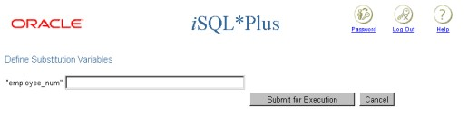
Using the & Substitution Variable
Use a variable prefixed with an ampersand (&) to prompt the user for a value.
SELECT FROM | employee_id, employees | last_name, salary, department_id
WHERE | employee_id = |  | &employee_num | ;
1-194
Badgujar Dipak D

Slide 5


Using the & Substitution Variable
2
101
1
1-195
Badgujar Dipak D

Slide 6



Character and Date Values with Substitution Variables
Use single quotation marks for date and character values.
SELECT last_name, department_id, salary*12 FROM employees
WHERE job_id = '&job_title' ;
1-196
Badgujar Dipak D

Slide 7

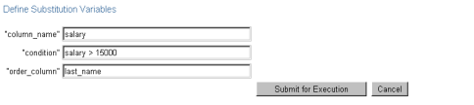

Specifying Column Names, Expressions, and Text
SELECT
employee_id, last_name, job_id,
&column_name
FROM
employees
WHERE ORDER BY
&condition
&order_column ;
1-197
Badgujar Dipak D

Slide 8
Defining Substitution Variables
You can predefine variables using the iSQL*Plus
DEFINE command.
DEFINE variable = value creates a user variable with the CHAR data type.
If you need to predefine a variable that includes spaces, you must enclose the value within single quotation marks when using the DEFINE command.
A defined variable is available for the session
1-198
Badgujar Dipak D

Slide 9


DEFINE and UNDEFINE Commands
A variable remains defined until you either:
Use the UNDEFINE command to clear it
Exit iSQL*Plus
You can verify your changes with the DEFINE
command.
DEFINE job_title = IT_PROG DEFINE job_title
DEFINE JOB_TITLE = "IT_PROG" (CHAR)
UNDEFINE job_title DEFINE job_title
SP2-0135: symbol job_title is UNDEFINED
1-199
Badgujar Dipak D

Slide 10

Using the DEFINE Command with
& Substitution Variable
Create the substitution variable using the DEFINE
command.
DEFINE employee_num = 200
Use a variable prefixed with an ampersand (&) to substitute the value in the SQL statement.
SELECT employee_id, last_name, salary, department_id
FROM employees
WHERE employee_id = ;
&employee_num
1-200
Badgujar Dipak D

Slide 11

Using the && Substitution Variable
Use the double-ampersand (&&) if you want to reuse the variable value without prompting the user each time.
SELECT employee_id, last_name, job_id, FROM employees
&&column_name
ORDER BY &column_name;
…
1-201
Badgujar Dipak D

Slide 12


Using the VERIFY Command
Use the VERIFY command to toggle the display of the substitution variable, before and after iSQL*Plus replaces substitution variables with values.
 | SET VERIFY ON
SELECT employee_id, last_name, salary, department_id FROM employees WHERE employee_id = &employee_num;
old 3: WHERE employee_id = &employee_num
new 3: WHERE employee_id = 200
1-202
Badgujar Dipak D

Slide 13






Customizing the iSQL*Plus Environment
Use SET commands to control current session.
SET system_variable value
Verify what you have set by using the SHOW
command.
SET ECHO ON
SHOW ECHO
echo ON
1-203
Badgujar Dipak D

Slide 14



SET Command Variables
ARRAYSIZE {20 | n}
FEEDBACK {6 | n |OFF | ON}
HEADING {OFF | ON}
LONG {80 | n}| ON | text}
SET HEADING OFF
SHOW HEADING HEADING OFF
1-204
Badgujar Dipak D

Slide 15

iSQL*Plus Format Commands
COLUMN [column option]
TTITLE [text | OFF | ON]
BTITLE [text | OFF | ON]
BREAK [ON report_element]
1-205
Badgujar Dipak D

Slide 16

The COLUMN Command
Controls display of a column:
COL[UMN] [{column|alias} [option]]
CLE[AR]: Clears any column formats
HEA[DING] text: Sets the column heading
FOR[MAT] format: Changes the display of the column using a format model
NOPRINT | PRINT
NULL
1-206
Badgujar Dipak D

Slide 17




Using the COLUMN Command
Create column headings.
COLUMN last_name HEADING 'Employee|Name' COLUMN salary JUSTIFY LEFT FORMAT $99,990.00
COLUMN manager FORMAT 999999999 NULL 'No manager'
Display the current setting for the LAST_NAME
column.
COLUMN last_name
Clear settings for the LAST_NAME column.
COLUMN last_name CLEAR
1-207
Badgujar Dipak D

Slide 18
COLUMN Format Models
Element | Description | Example | Result
9 | Single zero-suppression digit | 999999 | 1234
0 | Enforces leading zero | 099999 | 001234
$ | Floating dollar sign | $9999 | $1234
L | Local currency | L9999 | L1234
. | Position of decimal point | 9999.99 | 1234.00
, | Thousand separator | 9,999 | 1,234
1-208
Badgujar Dipak D

Slide 19

Using the BREAK Command
Use the BREAK command to suppress duplicates.
BREAK ON job_id
1-209
Badgujar Dipak D

Slide 20



Using the TTITLE and BTITLE Commands
Display headers and footers.
TTI[TLE] [text|OFF|ON]
Set the report header.
TTITLE 'Salary|Report'
Set the report footer.
BTITLE 'Confidential'
1-210
Badgujar Dipak D

Slide 21
Using the TTITLE and BTITLE Commands
Display headers and footers.
TTI[TLE] [text|OFF|ON]
Set the report header.
TTITLE 'Salary|Report'
Set the report footer.
BTITLE 'Confidential'
1-211
Badgujar Dipak D

Slide 22
Creating a Script File to Run a Report
Create and test the SQL SELECT statement.
Save the SELECT statement into a script file.
Load the script file into an editor.
Add formatting commands before the SELECT
statement.
Verify that the termination character follows the SELECT statement.
1-212
Badgujar Dipak D

Slide 23
Creating a Script File to Run a Report
Clear formatting commands after the SELECT
statement.
Save the script file.
Load the script file into the iSQL*Plus text window, and click the Execute button.
1-213
Badgujar Dipak D

Slide 24
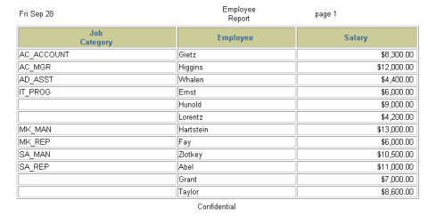
Sample Report
…
1-214
Badgujar Dipak D

